Slide 1

Retail Innovation Lab
Solutions Briefs

Slide 2
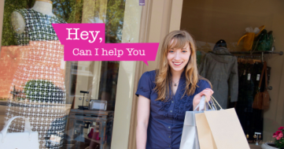
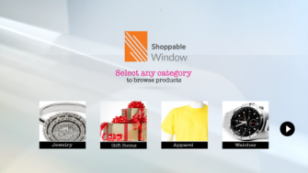
1. Shoppable Window
Business Scenario:
Imagine a scenario where you are rushing to your favourite retail store, late at night, and are disappointed to find the store closed. TCS Shoppable Window mitigates customer’s disappointment and allows the retailer to engage with the customer 24x7!
Solution:
Smart Window is a Kinect based solution which enables the customer to browse through various products offered by the retailer by using simple hand gestures.
An LED screen is placed inside the shop, facing the shop window. As soon as the Kinect sensor detects the customer, the solution displays the landing page. The landing page educated the customer on how to navigate through the solution. The Customer can browse through all the product categories using simple hand gestures.
Once the customer select a category, all the products in that particular category will be displayed. To browse through the various products, customer has to just swipe his hand from left to right or vice versa.
The customer can easily add any product to his shopping cart/wish list by scanning the QR code using the retailer’s consumer app on his smartphone. TCS Smart Window gives a very convenient, unique and exciting shopping experience to the customers!
Requirements:
OS: Windows 7 Platform, MS Kinect sensor for Windows and a display device

Slide 3
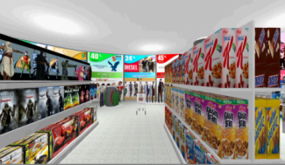
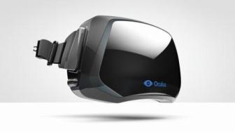
2. ImmShop – A fully Immersive 3D Shopping
Solution
A fully immersive individualised 3D shopping experience using HUD showcasing the future of online shopping. It enables customers to perform all the actions he/she normally performs in a real store using simple gestures.
Traditional online shopping entails navigating web pages with lots of text & command buttons. Immshop provides a fully immersive virtual environment for shoppers to navigate aisles, browse products and walk around the store in a virtual environment just like how they would shopping in a real world
How it works
The shoppers wear a heads up display (HUD) to view a individually customized virtual store in first person view. They will be able to push their cart / take their shopping baskets, and walk around the store. They can pick up the products they would like to buy and place them in their carts. When their shopping is done they can simply invoke the checkout kiosk which in turn completes this online transaction.
Key Features
Physical movements within this virtual store environment is achieved through simple gestures. The ability to create a customized virtual store for each shopper is a key feature of this solution. Also by a click of a button, store design/layout can be rearranged. From a consumer point of view, shopping can be done as a social event, ie, one can invite his/her friends to shop with them and have real conversations in real time though both are in two different physical locations but doing their shopping together online.
Requirements
Oculus Rift HUD, A Windows Laptop

Slide 4
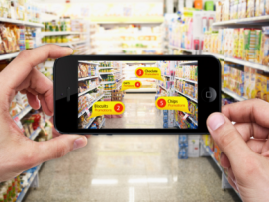
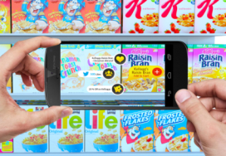
4. AR Navigator
Solution :
Augmented Reality Navigator is a smartphone app that identifies different categories/ products within the store via an AR interface of a mobile device and on the basis of these inputs offers relevant category/product information.
How it Works
Augmented Reality Navigator will virtually overlay category/product related information (Eg: Promotions, Social view) by identifying the category when the customer uses his retailer app and browses through the app over the aisles of the store. Depending upon the products/categories that are viewed in the aisle of the store, the app will be overlaying promotions/offers, social view and interesting product level information. The customer can then add the product to his wish list from the product view screen. The customer will also have the category level information with the number of promotions in each category when he browses at an aisle level.
Augmented Reality Navigator is designed in such a way that, at all times, the customer can exit any particular product view with its promotions and social content info by just moving to the next product displayed without performing any action.
Key Features
The solution helps customers immensely in getting promotion details in real time by just browsing the aisles of the store with your phone.
Requirements :
Smart phone, Retailer app

Slide 5
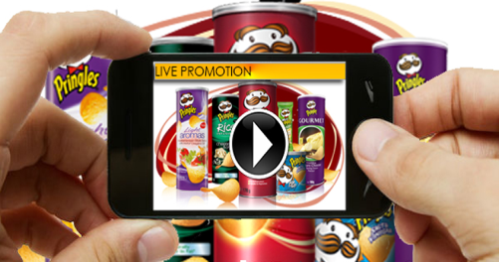
5. Live Promotion
Solution :
Live Promotion is a smartphone app that identifies different products via an AR interface of a mobile device and on the basis of these inputs offers relevant product ad (video). The hyper video is linked to the product page where the product could be added to the cart and checked out.
How it Works:
Live Promotion will virtually overlay product related hyper video (Eg: Ads) by image matching the product when the customer uses his retailer app and browses through the app over the physical products or banners of the products. Depending upon the products/banners of products that are viewed, the app will be overlaying a hyper video. The customer needs to tap the hyper video link to view the ad video of the product. The customer can then tap on the product while the video plays and will be directed to the product description page of the where they can add the product to their cart and do a checkout.
Key Features :
The solution helps customers immensely in buying products in real time by just browsing the products/banners of products outside the store with your phone, there by giving a unique shopping experience to the customers !
Requirements :
Smart phone, Retailer app

Slide 6
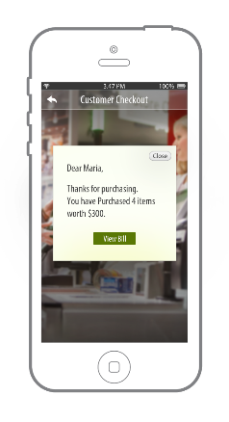
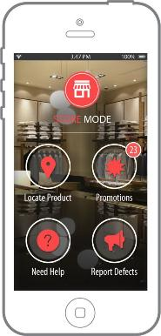
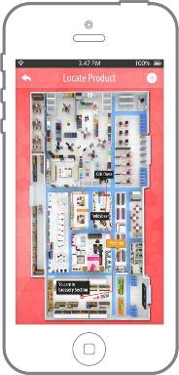
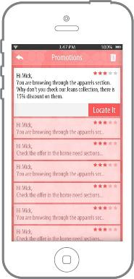
TCS offerings – iBeacon Shopper
In-store recognition & On-demand assistance
Personalized guidance in-store
Location Based Services for in-store customer engagement
Contextual product discovery & promotions
Simple and faster check-outs
Faster delivery of Store Pickups
TCS is leveraging Beacon Technology for in-store Customer engagement with pre-built solution accelerators to provide location based services for contextual and personalized engagement, and to elevate in-store shopping experiences

Slide 7
More Solutions…
Digital Wardrobe – A smartphone based solution which can store a list of shopped apparels. It can also suggest apparels to match with the existing or the new ones based on a lot of factors like weather forecast, appointment schedule, fashion trends etc.
Wearable Assistant – A wearable solution for the store associate to efficiently organize and perform day-to-day tasks and activities in-store using smart glass.
Wellness Rewards – A smartphone based solution which monitors and keeps track of the activity of the users using FitBit and connects it to loyalty and rewards.
Retail Telematics – A tablet based application to push notifications on the items available in the wish list while passing through the store. It can also provide location based service, automated pickup service and virtual assistant service on the car dashboard.

Slide 8
More Solutions…
Virtual Fit – A Microsoft Kinect based size measurement application that measures users in real time and recommends best fit sizes and also allows them to try on all the clothes available in the store.
Gap Scan – A solution for retailers wherein it alerts the Store Manager for gaps in product shelves.
Self-Driving Cart – An autonomous shopping trolley solution which communicates with the customer before and during the shopping, and helps the customer navigate through the store based on the customer’s shopping list without any manual intervention.
VPick – A smartphone based solution which optimizes the supply chain by using alternate delivery channels by utilizing the existing unused resources like store employees or customers belonging to the same locality to deliver the purchase order for other customers.

Slide 9
Recently developed (Jul-Aug ‘ 15)
Virtual Fit – A Microsoft Kinect based size measurement application that measures users in real time and recommends best fit sizes and also allows them to try on all the clothes available in the store.
Product Discoverer – A location-aware iPhone app that will provide promotions and on the spot relevant information on products using iBeacon technology.
LiFi Discover – A smartphone based solution which offers a variety of in-store services like digital receipt transfer and transfer of data heavy contents to the shoppers using Li-Fi, based on their location i.e. Recipe.
Unwrap – A smartphone based solution which helps in viewing the products inside packages in an interactive manner.
Holographic Product Assistant – A holographic device which can assist customers and enhance their shopping experience in the store. It displays an interactive hologram of products in great detail and also contains information related to the products.

